Slide 1
Cloud based Security
Presenter : Sarbani Paul

Slide 2
What is cloud security
Cloud computing security or, more simply, cloud security is an evolving sub-domain of computer security, network security, and, more broadly information security. It refers to a broad set of policies, technologies, and controls deployed to protect data, applications, and the associated infrastructure of cloud computing.

Slide 3
Why cloud security is required?
Increasing demands of internet user for cloud computing environment has created database security as critical issue. Along with other issues, main critical issue is security. It is because of variety of IT services, who is providing services through a cloud environment.
When a company choose cloud computing, and expose their database in virtual environment, they risk to expose their highly sensitive data for internal and external attacks. Cloud-based security uses a cloud computing platform as the means for delivering security to protect endpoints without the usual large client footprint that is typical of traditional software based endpoint security solutions. Instead, a small client is installed on an endpoint.

Slide 4
Computer Security
The process of detecting and preventing unauthorized use of computer is called computer security. It involves process of safeguarding the computer from any kind of attack. It maybe for hacker's own benefit or leaving malicious content in your system.

Slide 5
Areas of concern for computer security
Confidentiality - Confidentiality states about access of data and information should be only for authorized user.
Integrity - Integrity states about modification of data can be done only by authorized user.
Availability - Availability states about ability to reach to data by authorized user, when needed.
Authentication - Authentication states about the source of communication. Communication should really happen between them, among which it is intended.

Slide 6
Different approach of safety
Software solutions:
Anti-virus, firewalls or other security software has been installed between the network boundary and servers. It leaves few ports open to communicate for email, Instant messaging and web. Specific configuration for hardware and software used to be needed for these software solutions. After installing these software. These should be kept as updated always to work efficiently. These updates generally have latest files to combat with any known - unknown viruses.
These software checks all incoming mails and communication for any threat as per the definition available with that. Updating security software is equal to updating their definitions. It generally checks for any web content we are trying to access, and notify us in case of any threat.

Slide 7
Appliance solutions:
Appliances are hardened servers. In case of appliance solutions, one or more of these hardened servers has to be installed between network boundary and internal resources. Here internal resource can be email server or any endpoint client server.
The hardware and time to configure these servers varies based on the size of company and resources. If company usage of mail and internet grows, then security needs will also grow likewise. So, time to time monitoring for additional resources is needed.
Apart from this one person should be dedicated to monitor the threat. Configuration should be regularly adjusted as per latest malware trends. Technical support also requires for internal users.

Slide 8
Cloud service providers:
A cloud service provider uses a remote server over network of data centers to provide service for their client. These data centers used to be located at major internet hubs. At these data centers, they process email and internet traffic for their client.
As per the customer requirement, cloud service has been provided to them after making a quick modification of the client's setting. These client setting includes, DNS and mail server setting. There is no need to configure any hardware and software in this case. It is administrated through a web base portal that provides management information, statistics and report in real time.
It is too much easier for an administrator to monitor the service. Performance report and service statistics can be gathered very easily. Any updates or upgrades can be implemented in real time. It used to made by cloud service provider only , so client should not be worried about any additional efforts.

Slide 9
Advantages of cloud based security
Implementation and maintenance
Reliability and scalability
Guaranteed levels of service
Total cost of ownership

Slide 10
Cloud computing infrastructure
Cloud computing is a model for enabling convenient and on-demand network access to a shared pool of configurable computing resources. These resources includes networks, servers, storage, applications and services. It can be rapidly configured and released with minimum effort or interaction to service provider.

Slide 11
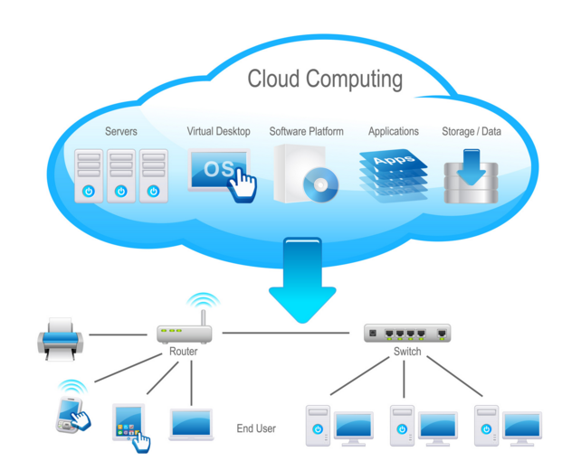
Cloud computing infrastructure

Slide 12
Conclusion
By knowing what can be leveraged from the cloud platform or service provider, we can develop security in our application without reinventing the capability within our application boundary thus avoiding costly “bolt-on” safeguards.
A good practice is to create security principles and architectural patterns that can be leveraged in the design phase. Architectural patterns can help articulate where controls are enforced (Cloud versus third party versus enterprise) during the design phase so appropriate security controls are baked into the application design.
Keep in mind the relevant threats and the principle of “risk appropriate” when creating cloud security patterns. Ultimately a cloud security architecture should support the developer’s needs to protect the confidentiality, integrity and availability of data processed and stored in the cloud.

Slide 13
THANK YOU

